Slide 1
Reinforcement Learning as Classification: Leveraging Modern Classifiers
By Michail G. Lagoudakis and Ronald Parr

Slide 2
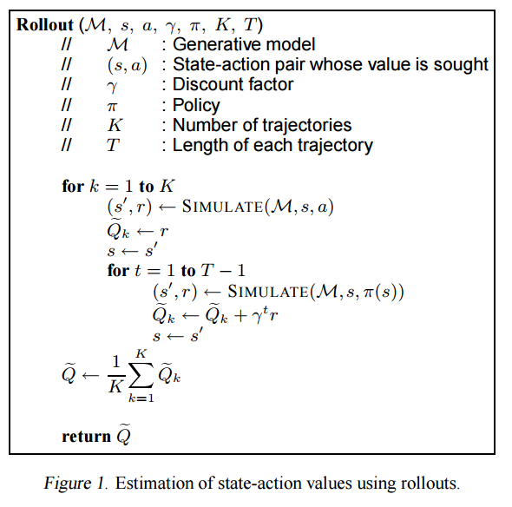
Using Rollout
In order to estimate which state action pairs leads to good reward given a specific policy, we can use a rollout policy to estimate the value of the pair.
Rollout works by starting the game in the state we are evaluating a performing the action we are testing. Then, the policy is followed until the game terminates.
This is performed K times and the estimate is the average of the cumulative reward over the K runs.

Slide 3
Updating the current policy
For every state we performed the rollout algorithm on, we find the action for which the best reward estimate was obtained.
Label this pair as a positive example.
Label the rest as negative examples as long as their reward estimate is significantly worse than the positive example.

Slide 4
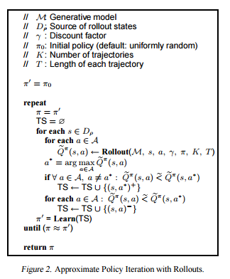
Using Classification to Build a Policy
Once we have obtained our labelled data, we can use any well known classifier on the data to learn a new policy.
For example, we can train a neural network only on the positive examples to predict, given a state which action should be taken.

Slide 5
Methodology
Evaluated the API method on a chain of 20 states, starting at state 0
Reward of -1 for any transition except to the terminal state 20. In which case reward is 50.
Can transition to 1,2 or 3 steps forward.
Used an SVM to predict which actions maximize the expected return.
Averaged out the cumulative reward over 10 runs.

Slide 6
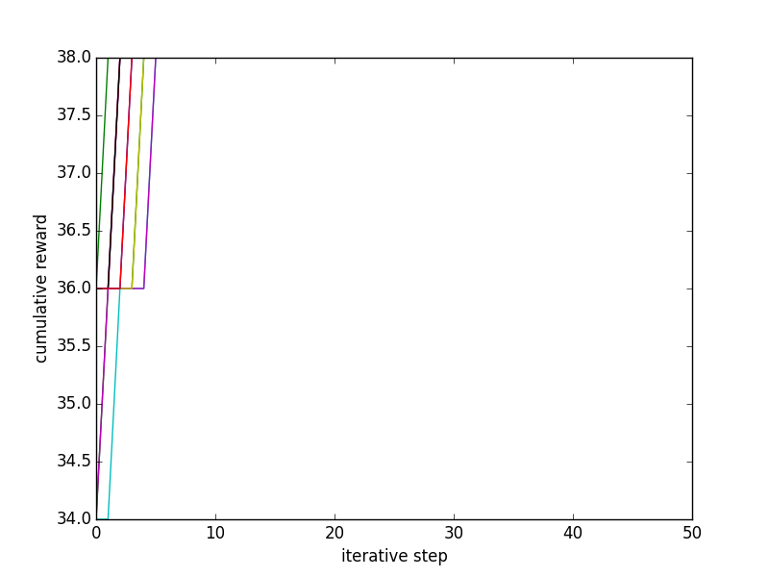
Results
The first observation is that the algorithm converges with a very small number of iterations
However, the best cumulative reward we obtain is 38, which is smaller than the optimal of 42.
This shows that this algorithm might benefit from some form of epsilon greedy policy when performing the rollouts.

Slide 7
Reference
[1]Reinforcement learning as classification: Leveraging modern classifiers, Michail G. Lagoudakis and Ronald Parr.

